Slide 1
K-Maps

Slide 2
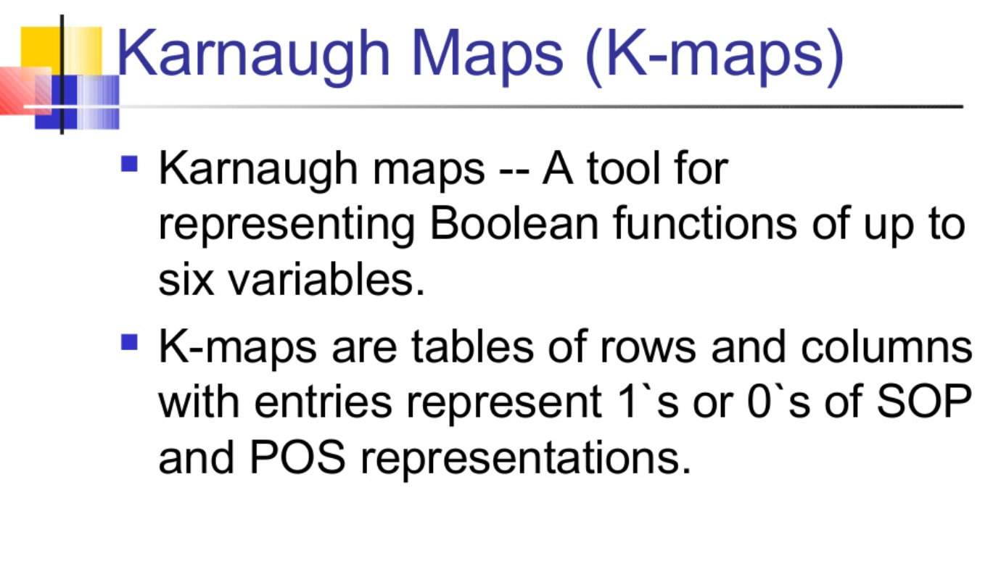
K- Maps

Slide 3
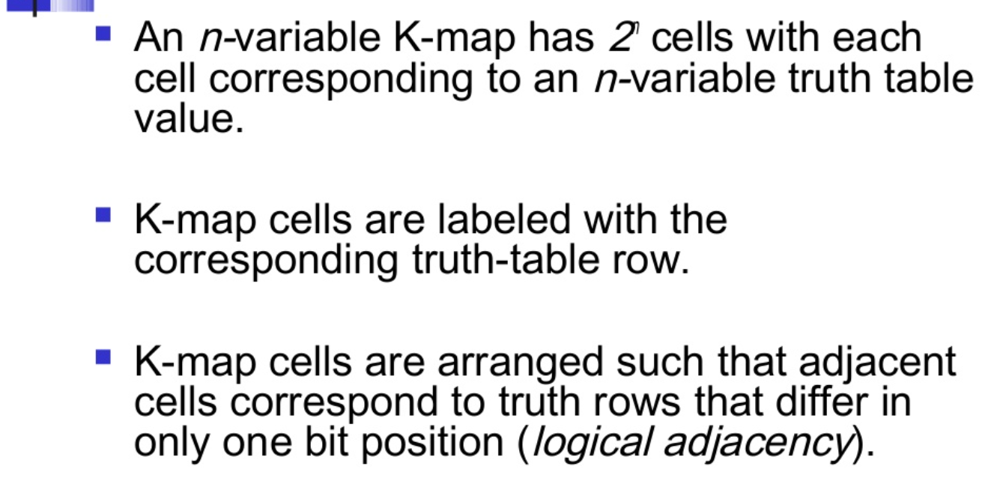

Slide 4
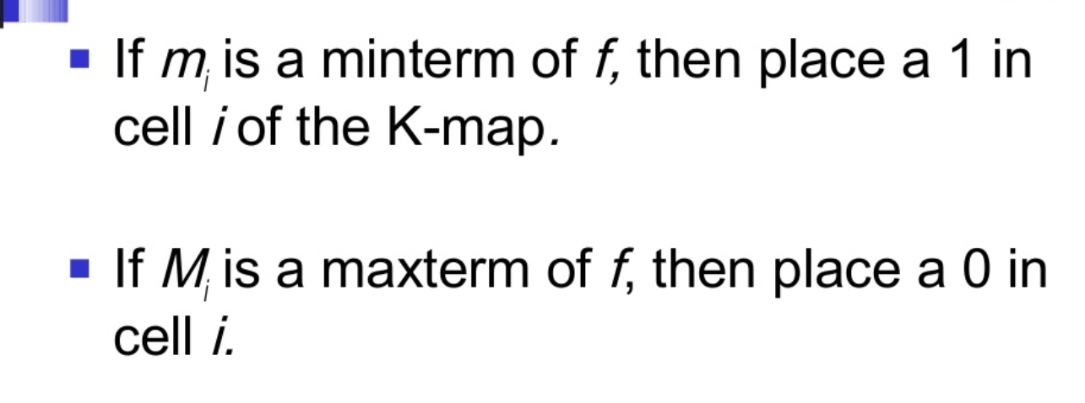

Slide 5
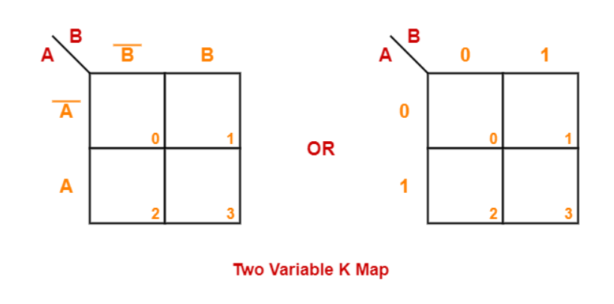
Examples of K-Maps:
2-variable K-map
Two variable K Map is drawn for a boolean expression consisting of two variables.
The number of cells present in two variable K Map = 2² = 4 cells.
So, for a boolean function consisting of two variables, we draw a 2 x 2 K Map.

Slide 6
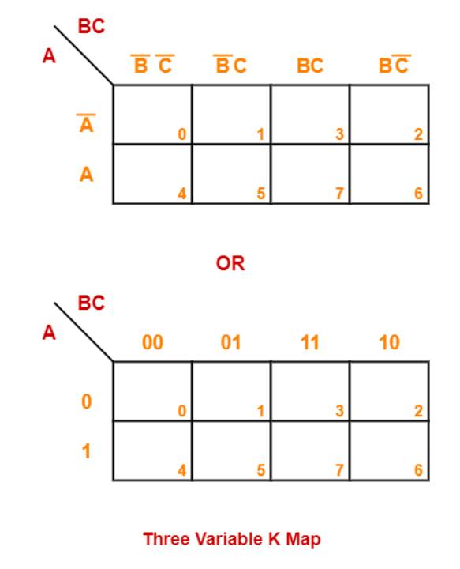
3-Variable K-Map:
Three variable K Map is drawn for a boolean expression consisting of three variables.
The number of cells present in three variable K Map = 2³ = 8 cells.
So, for a boolean function consisting of three variables, we draw a 2 x 4 K Map.

Slide 7
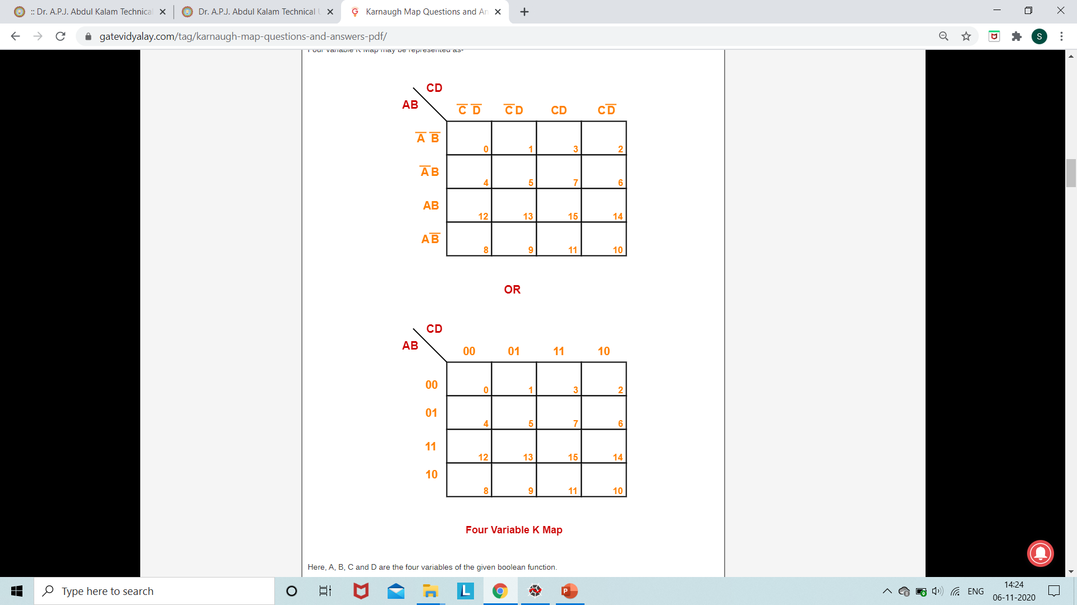
4-variable K-map
Four variable K Map is drawn for a boolean expression consisting of four variables.
The number of cells present in four variable K Map = 2⁴ = 16 cells.
So, for a boolean function consisting of four variables, we draw a 4 x 4 K Map.

Slide 8
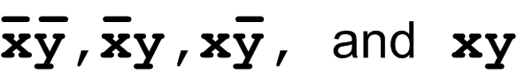
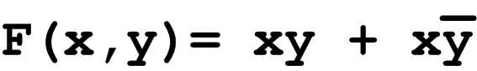
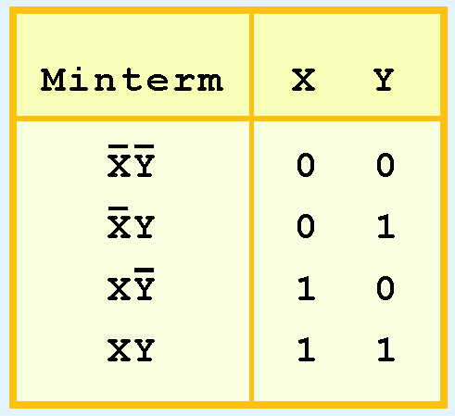
Description of Kmaps and Terminology
For example, the minterms for a function having the inputs x and y are:
Consider the Boolean function,
Its minterms are:

Slide 9
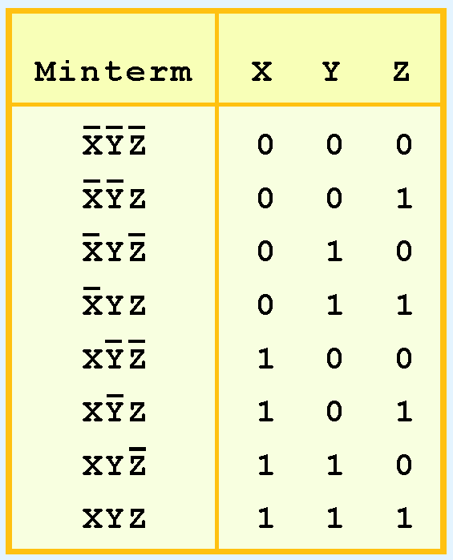
Similarly, a function having three inputs, has the minterms that are shown in this diagram.

Slide 10
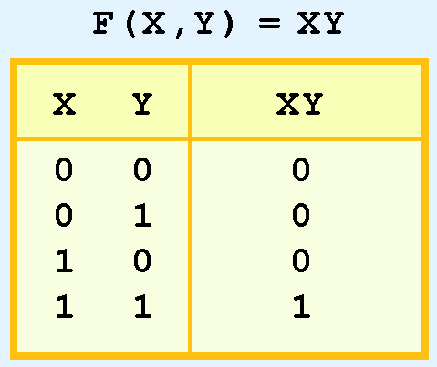
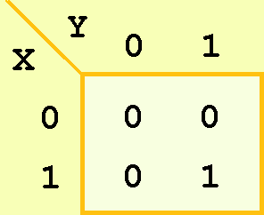
A Kmap has a cell for each minterm.
This means that it has a cell for each line for the truth table of a function.
The truth table for the function F(x,y) = xy is shown at the right along with its corresponding Kmap.

Slide 11
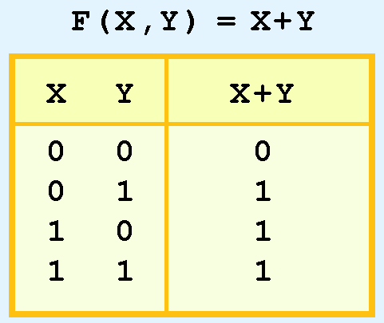
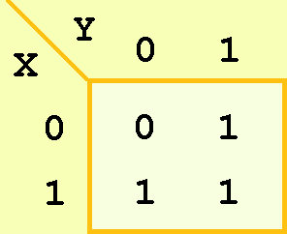
As another example, we give the truth table and KMap for the function, F(x,y) = x + y at the right.
This function is equivalent to the OR of all of the minterms that have a value of 1. Thus:

Slide 12
Simplification Using K-Maps:

Slide 13
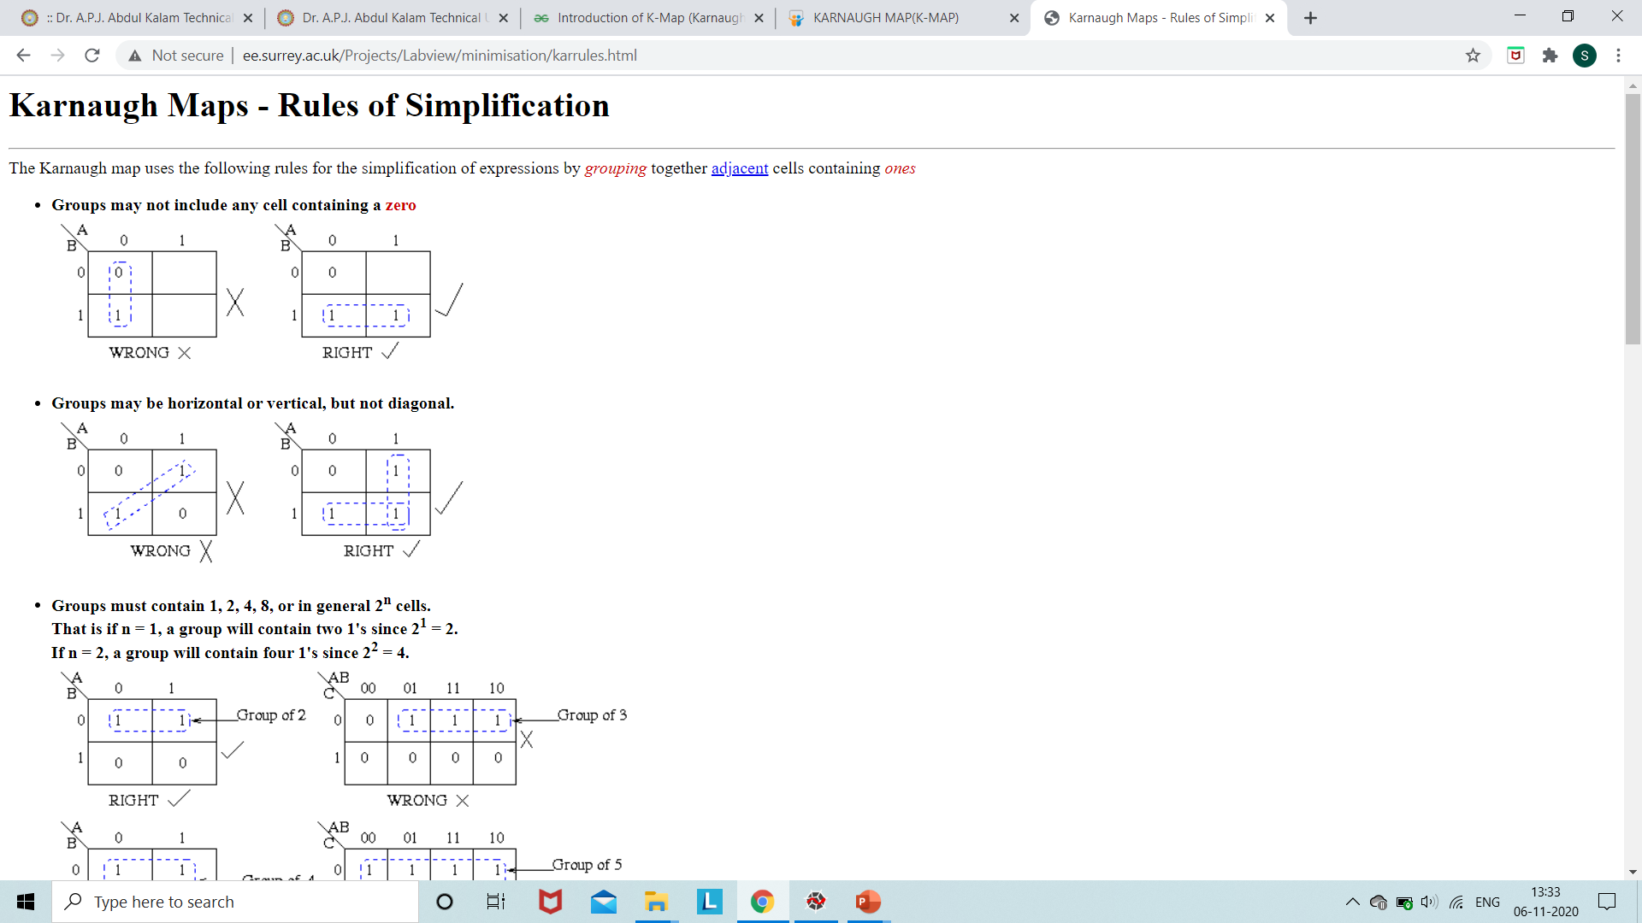
Rules of Simplification: SOP

Slide 14
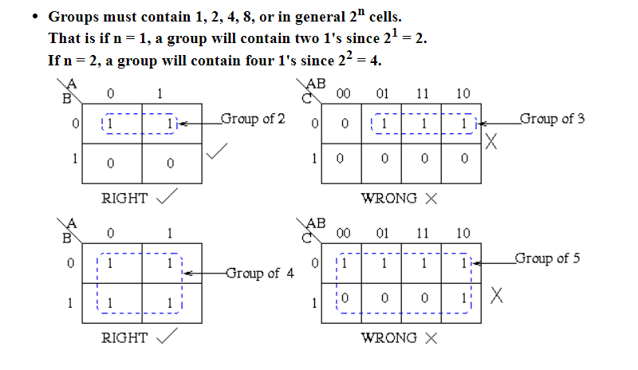

Slide 15
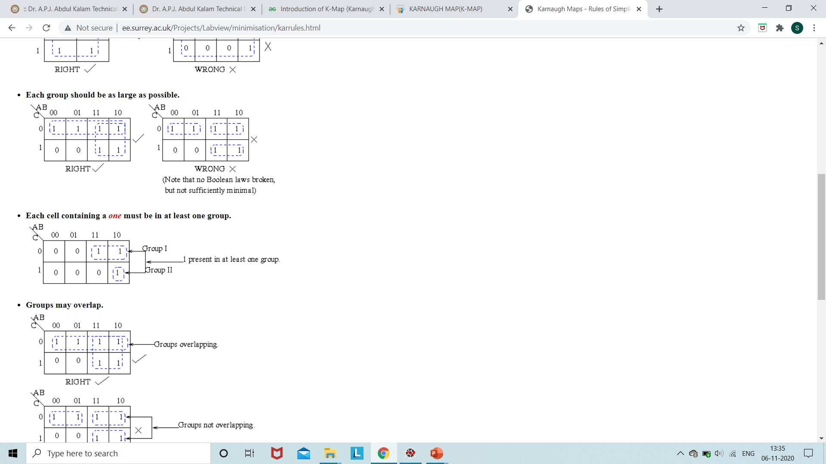

Slide 16
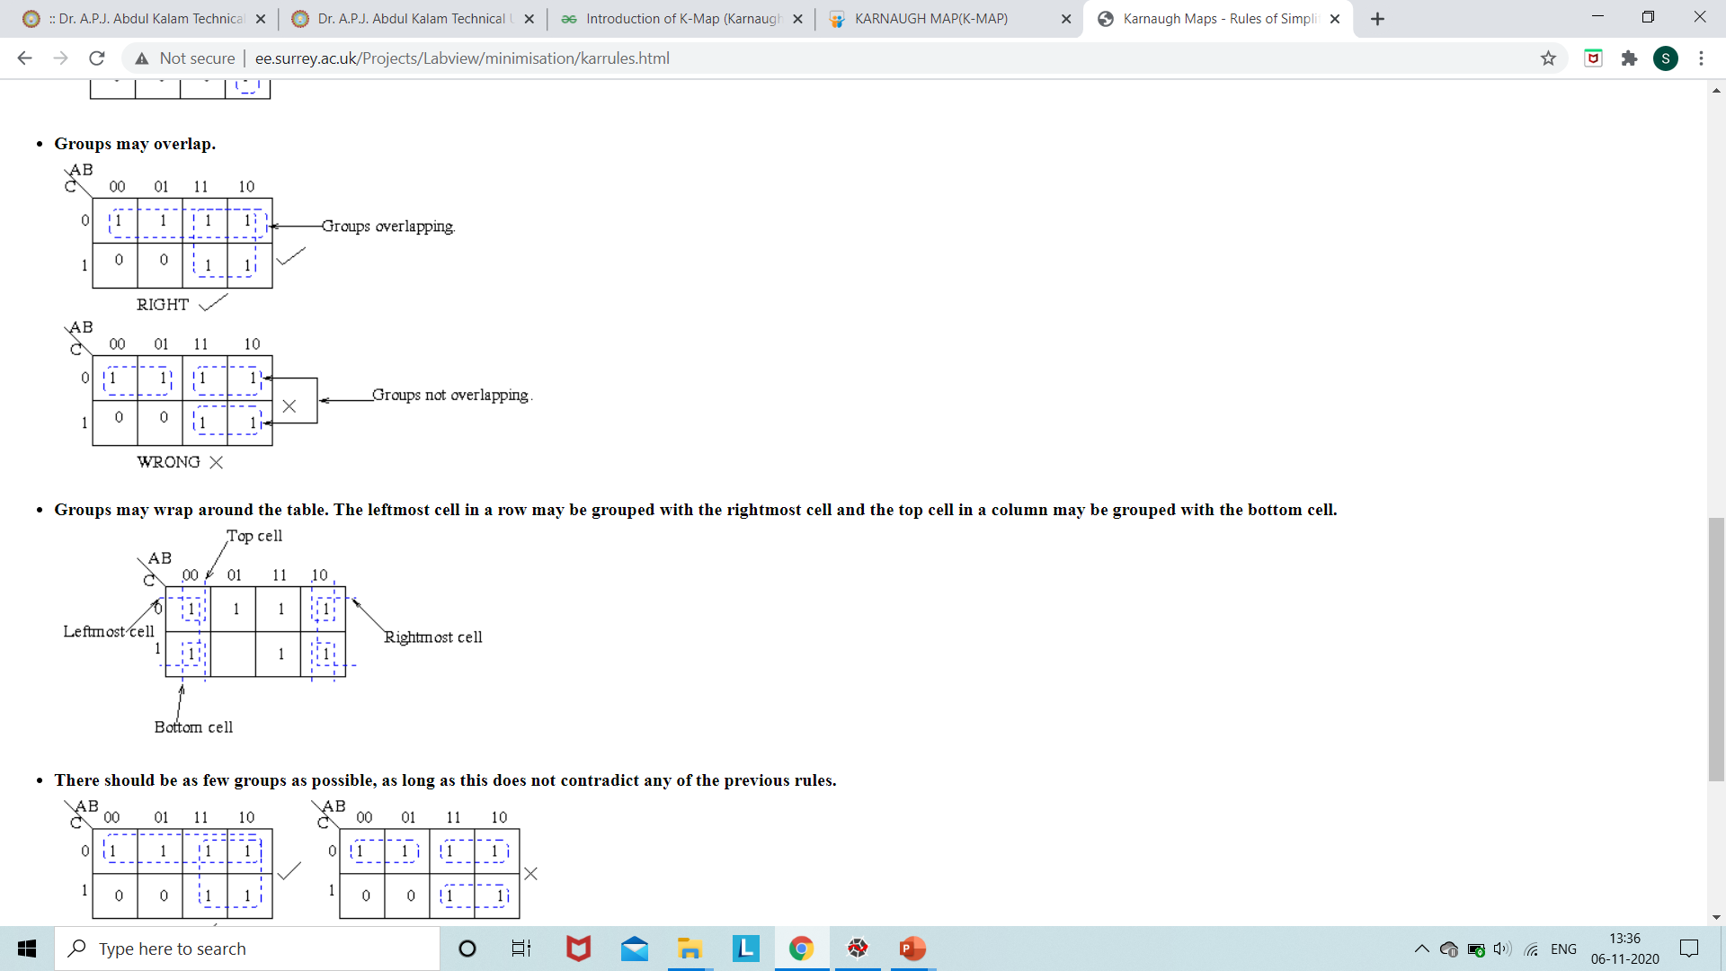

Slide 17
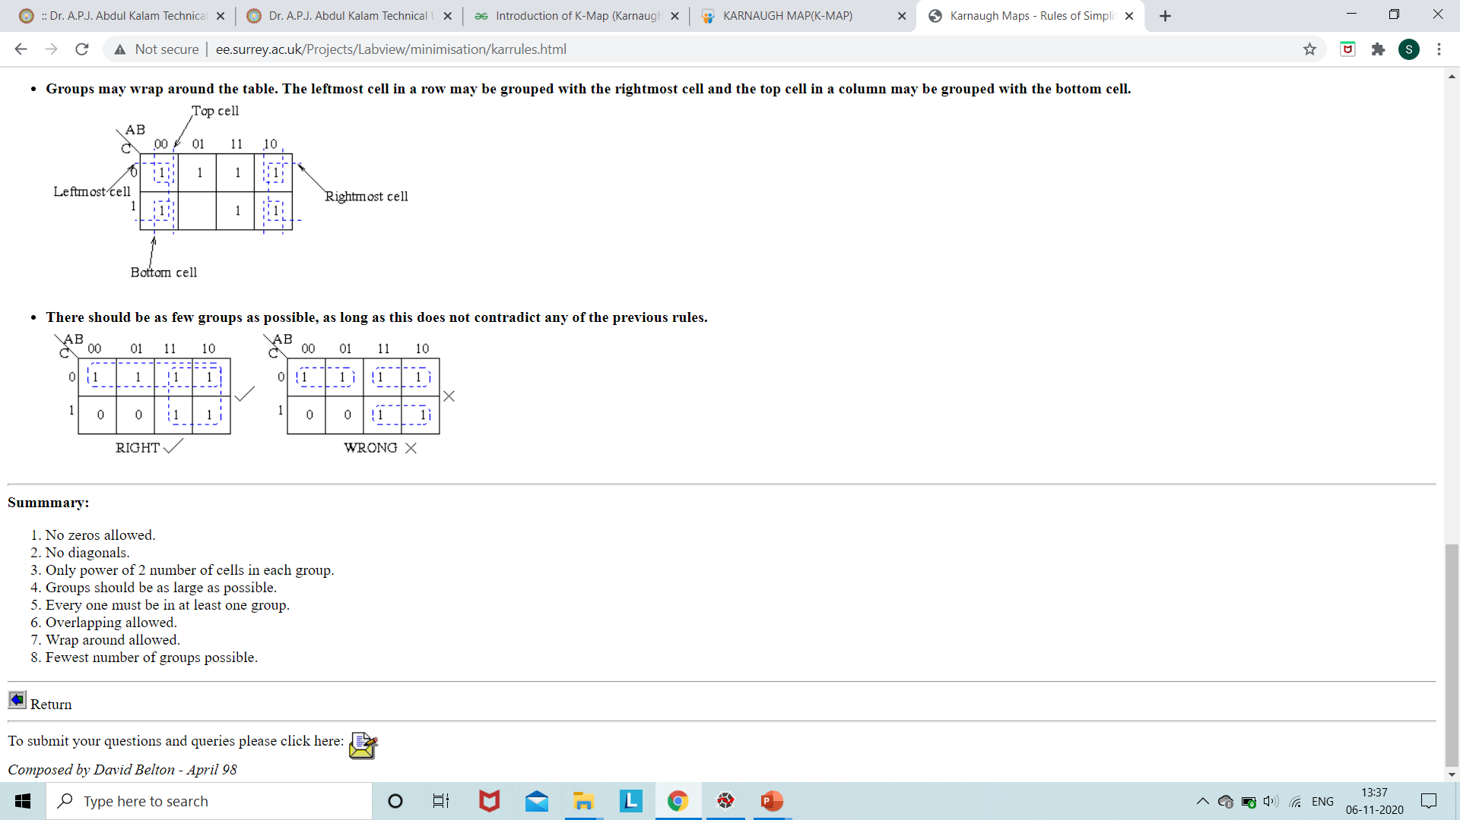

Slide 18
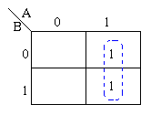
Examples:
Ques:1 Consider the following function. (i) Minimize using k-maps (ii) Algebric Simplification
The function plotted is: Z = f(A,B) = A + AB
Referring to the map the two adjacent 1's are grouped together. Through inspection it can be seen that variable B has its true and false form within the group. This eliminates variable B leaving only variable A which only has its true form. The minimised answer therefore is Z = A.

Slide 19
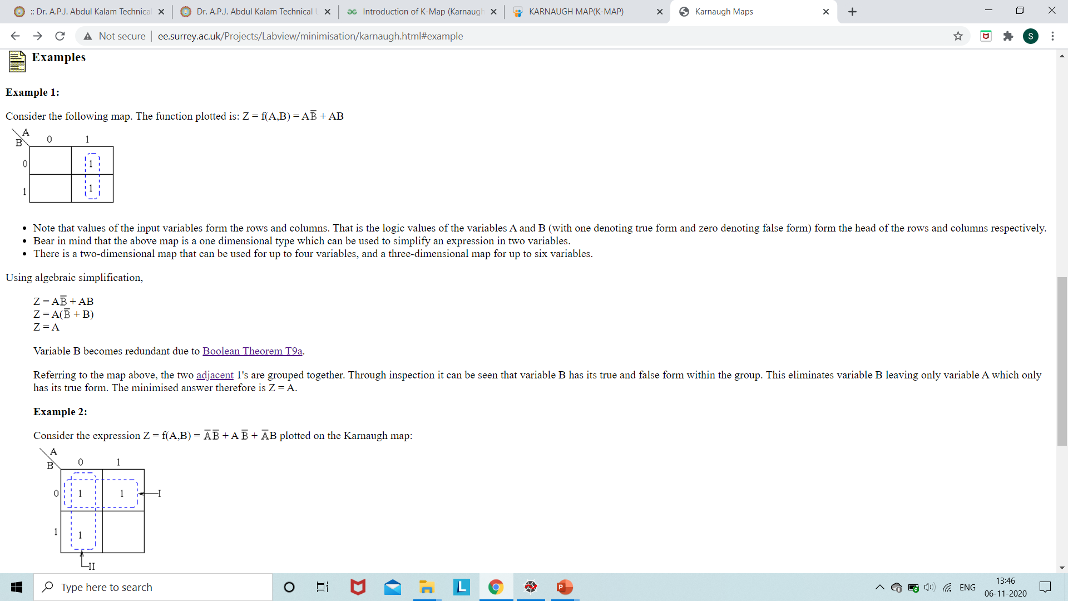

Slide 20
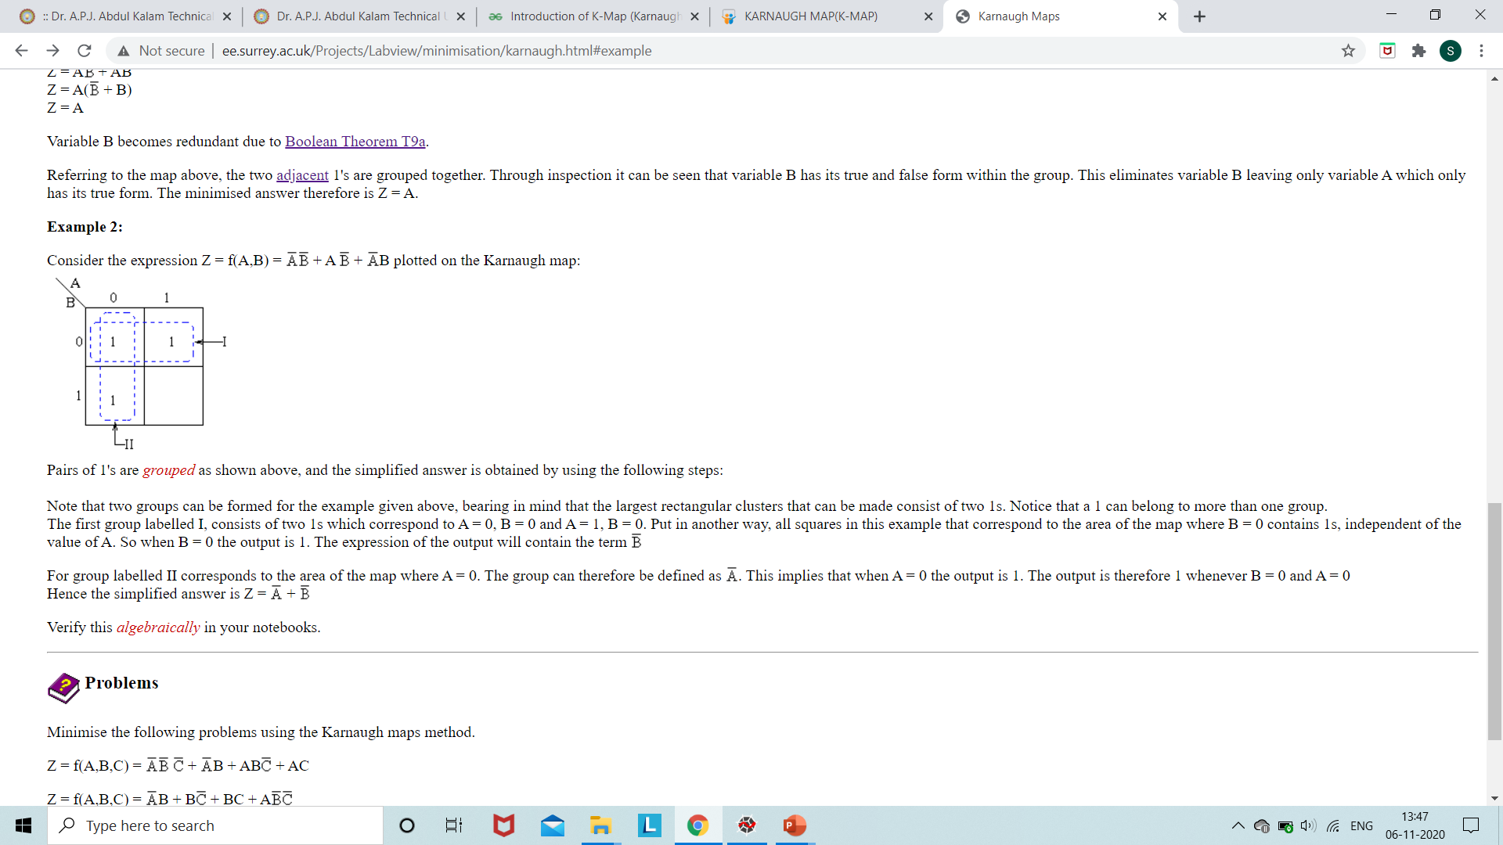

Simplified Answer:

Slide 21
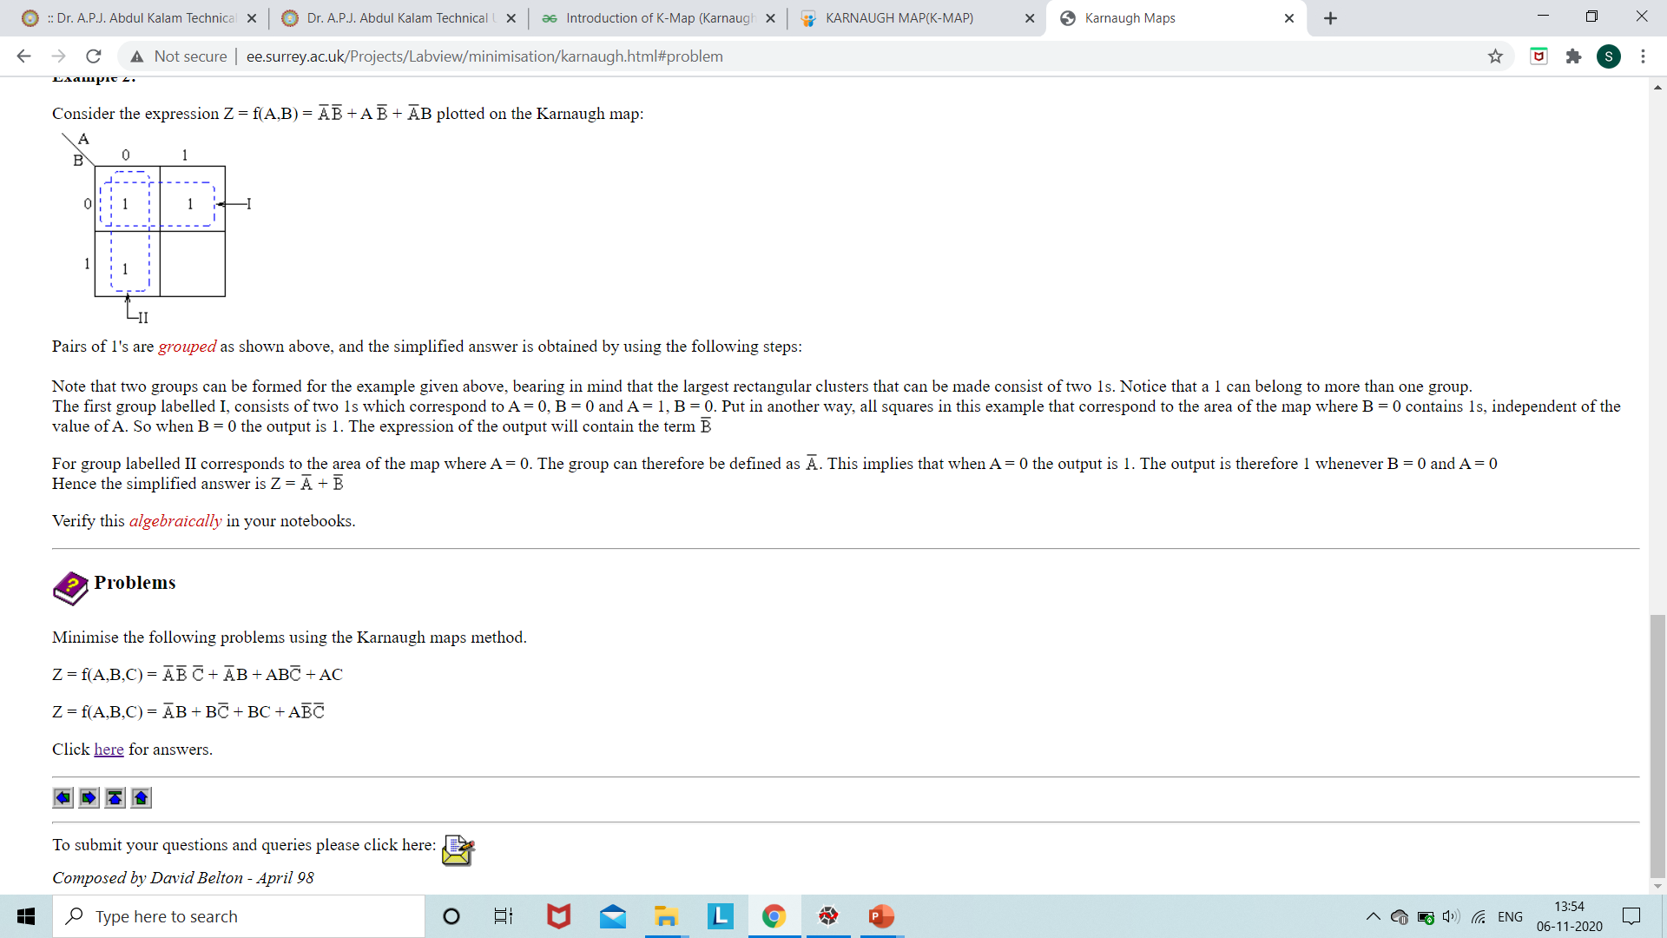
Z=F(P,Q,R,S)=∑(0,2,5,7,8,10,13,15)

Slide 22
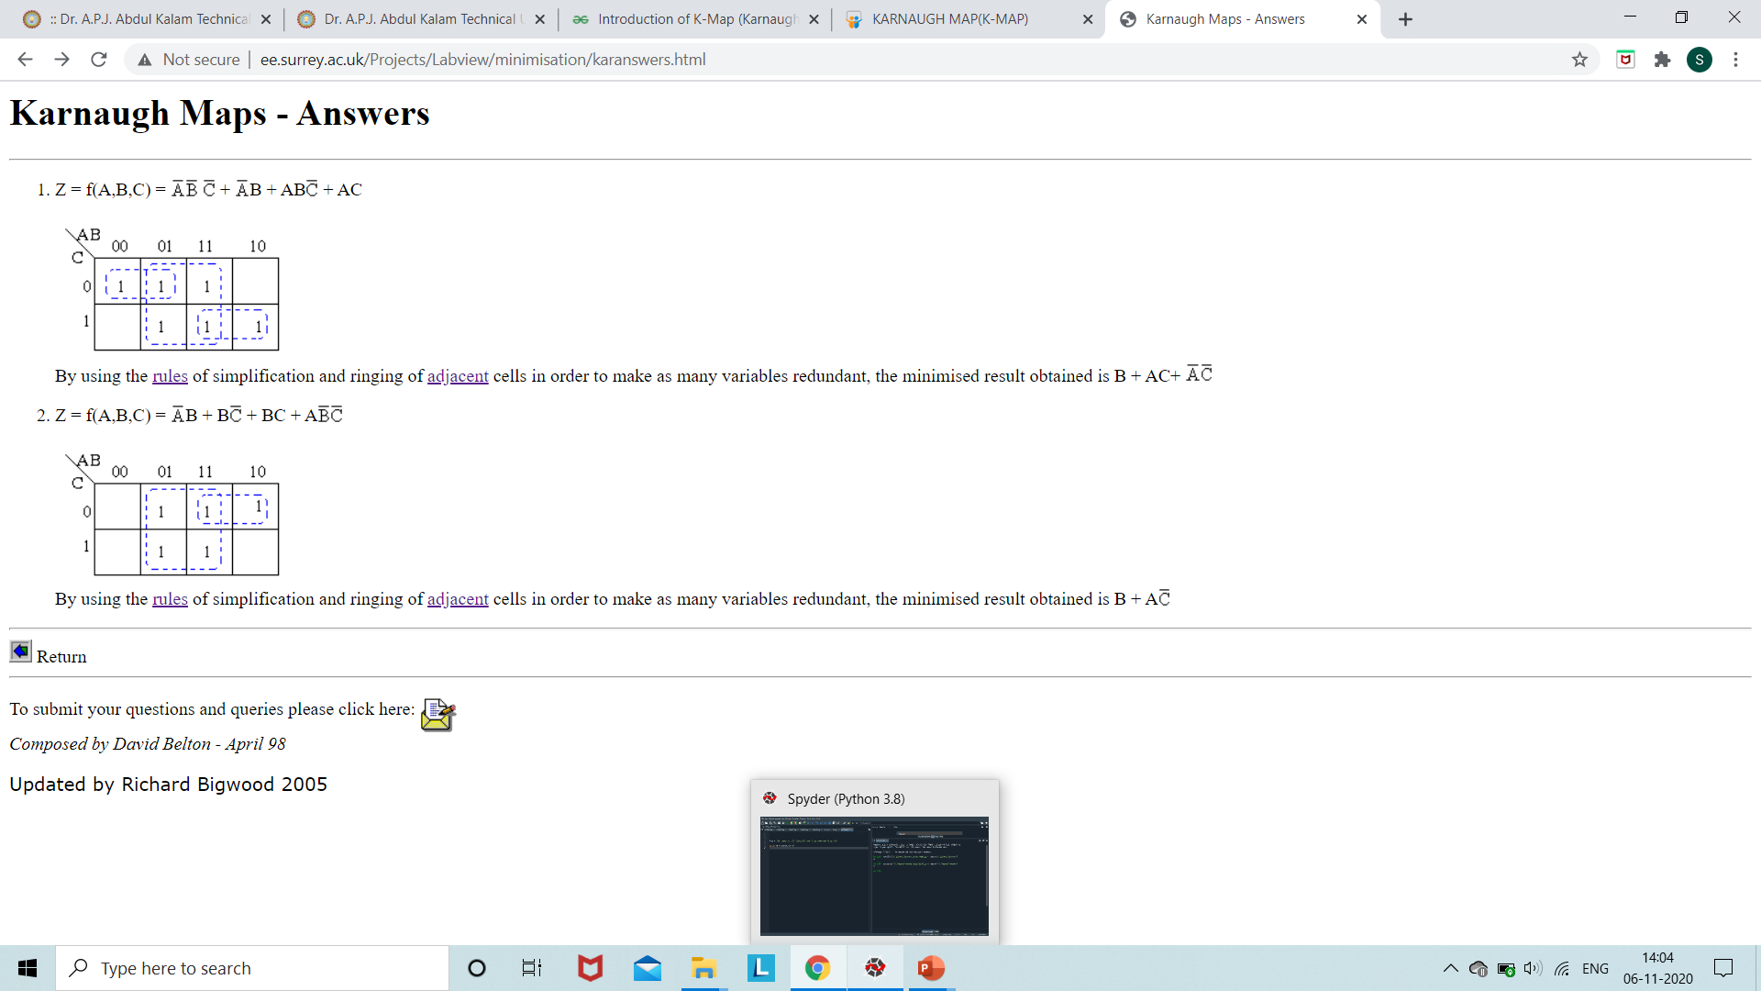

Slide 23
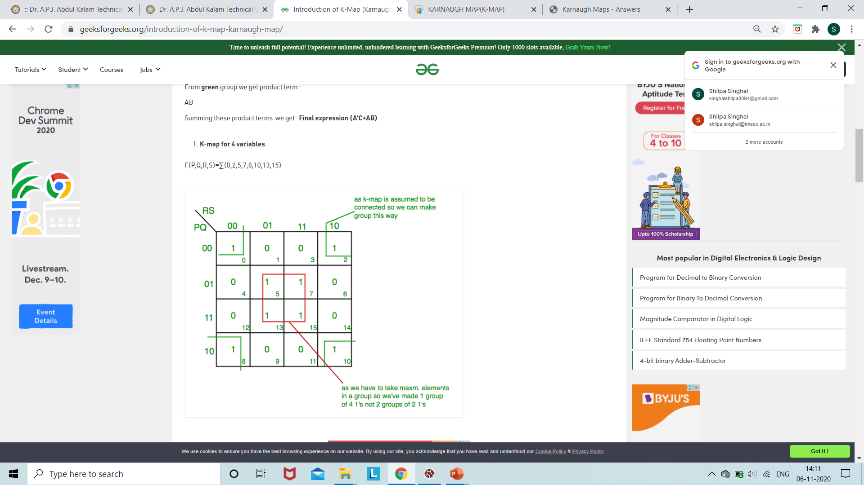
3.

Slide 24
From red group we get product term—
QS
From green group we get product term—
Q’S’
Summing these product terms we get- Final expression (QS+Q’S’)

Slide 25
POS Form:
Find the Expression using K-Maps.
1.F(A,B,C)=π(0,3,6,7)
2. F(A,B,C,D)=π(3,5,7,8,10,11,12,13)

Slide 26
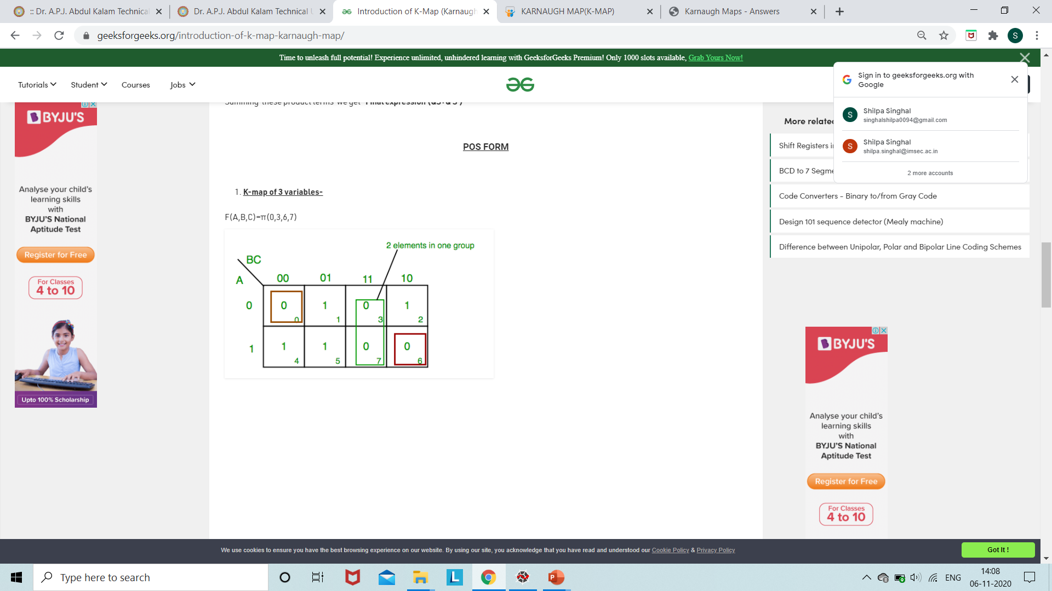

Slide 27
From red group we find terms
A B C’
Taking complement of these two
A’ B’ C
Now sum up them
(A’ + B’ + C)
From green group we find terms
B C
Taking complement of these two terms
B’ C’
Now sum up them
(B’+C’)
From brown group we find terms
A’ B’ C’
Taking complement of these two
A B C
Now sum up them
(A + B + C)
We will take product of these three terms :Final expression (A’ + B’ + C) (B’ + C’) (A + B + C)

Slide 28
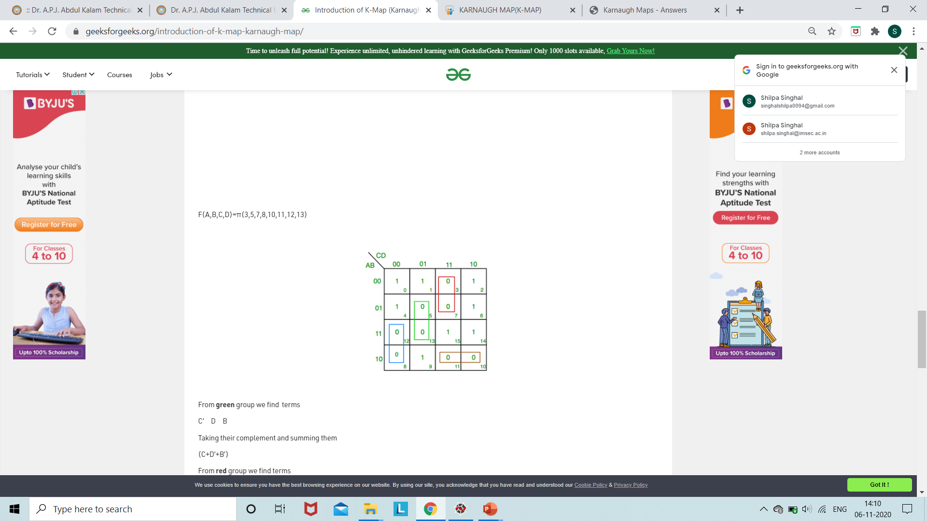

Slide 29
From green group we find terms
C’ D B
Taking their complement and summing them
(C+D’+B’)
From red group we find terms
C D A’
Taking their complement and summing them
(C’+D’+A)
From blue group we find terms
A C’ D’
Taking their complement and summing them
(A’+C+D)
From brown group we find terms
A B’ C
Taking their complement and summing them
(A’+B+C’)
Finally we express these as product –(C+D’+B’).(C’+D’+A).(A’+C+D).(A’+B+C’)

Slide 30
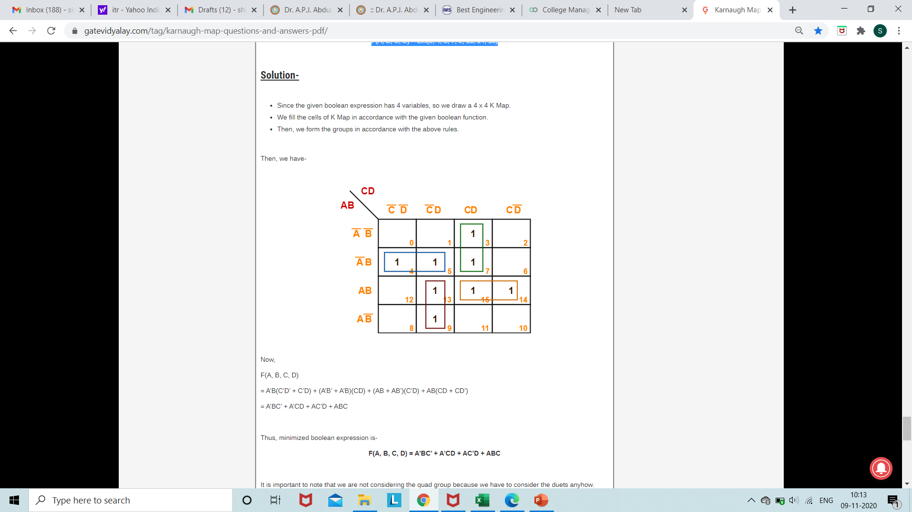
Minimize the following boolean function- F(A, B, C, D) = Σm(3, 4, 5, 7, 9, 13, 14, 15)

